Slide 1

Working Group 2
Evaluating national policies
Key Messages
17 May 2017

Slide 2

Presentation and discussion
Registration to the toolkit
Fill in the self-reflection tool
Discussion in small groups
Reporting
Related toolkit section:
http://www.cedefop.europa.eu/en/publications-and-resources/toolkits/vet-toolkit-upskilling-pathways/evaluate/self-reflection-tool

Slide 3
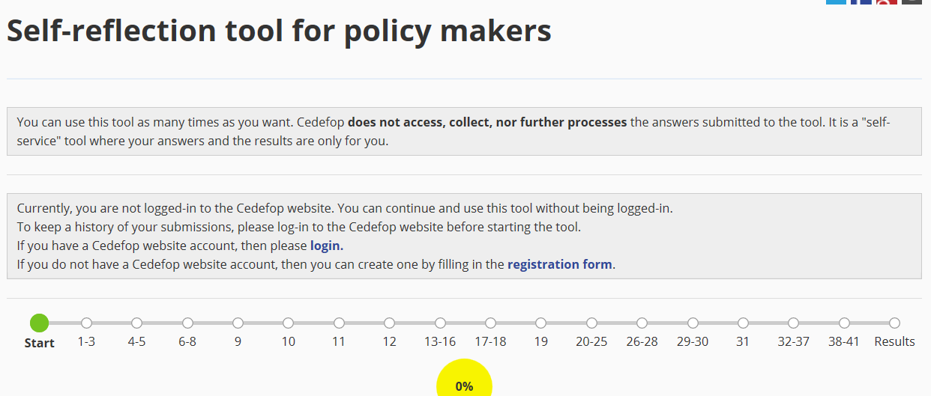
Questions

Slide 4
Questions
Are structural indicators clear?
Was the information helpful?
Do they fully address the issue of EL?
What other indicators should be included?
Proposed improvements
How could it be used and how would you contribute to its dissemination?

Slide 5
Key messages
Comprehensive and useful as a tool for reflection
  Specially for policy makers
  Can be used for informing others, as a follow up
Differentiation of target groups
  The most at risk identified
More visual presentation
Difficult to capture the diversity of policies
  Some compound questions inside
  Decentralization issues
  Additional items: Technical skills, career management skills, economic reasons for EL
  VET providers complexity (schools, companies, non-formal providers)

Slide 6
Key messages
Yes/No Answers
  “don’t know’? Not applicable? What if there is decentralisation
  Not only tackle the NO but the YES
  Feedback more sophisticated
Similarity of the questions
  Repetition – Control questions?
  Links can be worked out – If yes… then
Definitions and consistency of terms
  Mouse-over definitions (e.g. Career guidance and professional counselling)

