Slide 1

VET toolkit for tackling early leaving http://www.cedefop.europa.eu/TEL-toolkit
Expert panel:
llona Murphy, Marie Gitschthaler, Ward Nouwen, Becci Newton
Official launch by Irene Psifidou

Slide 2

Purpose of the toolkit
Guidance on how to identify and monitor early leavers or those at risk of early leaving
Guidance on how to intervene to (re)engage early leavers or those at risk of early leaving (successful approaches)
Guidance on how to evaluate measures to address early leaving
VE
The toolkit focuses on aspects that are specific to early leaving from VET, and in the potential benefits of using VET pedagogies as a means to tackle early leaving in general.

Slide 3
Target audience
Policy-makers at national, regional and local level
Practitioners at education and training providers
Practitioners at other services providing support measures

Slide 4
Overview of the methodology
Expert panel
Consultations with potential users
Cedefop
2nd-3rd-4th drafts
Several rounds of revisions
1st
drafts
Revised version
Language editing

Slide 5
Number of interviews conducted
 | Number of interviews
Scoping interviews | 20
Road testing – Wave 1 | 10
Road testing – Wave 2 | 19
Road testing – Wave 3 | 18
Interviews to gather information on the examples | 7
TOTAL | 74

Slide 6

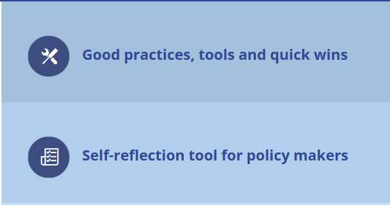
Toolkit Resources
 | Number of examples
Good practices | 39
Toolkits and tools | 35
Quick wins | 18
TOTAL | 92

Slide 7
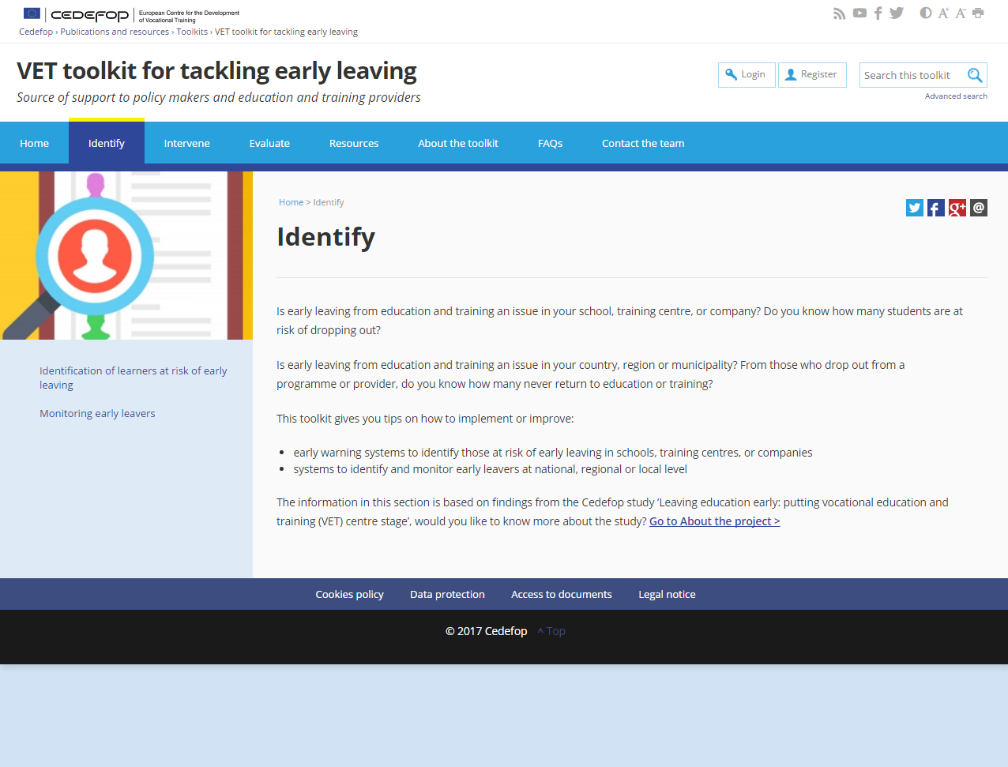

Slide 8
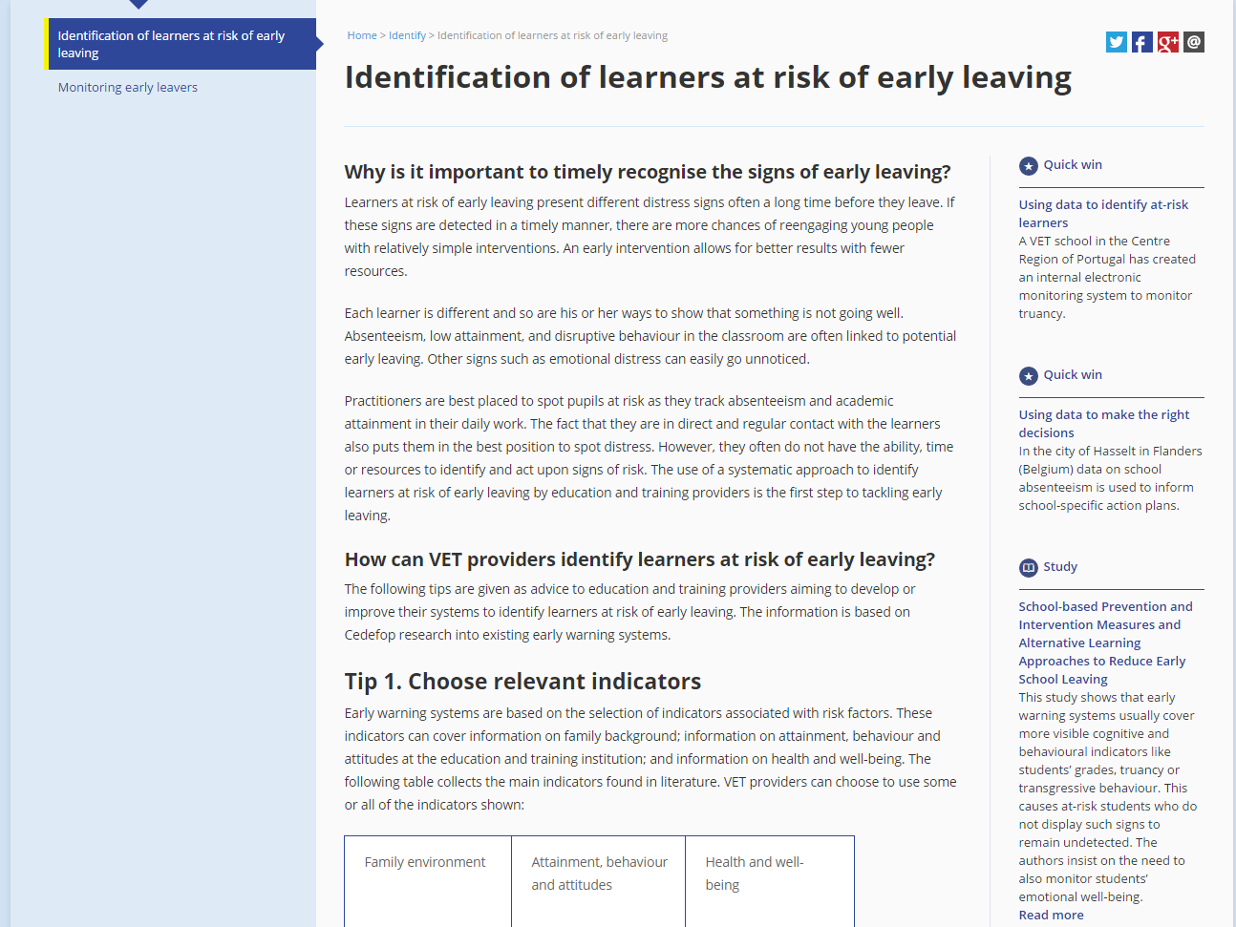

Slide 9
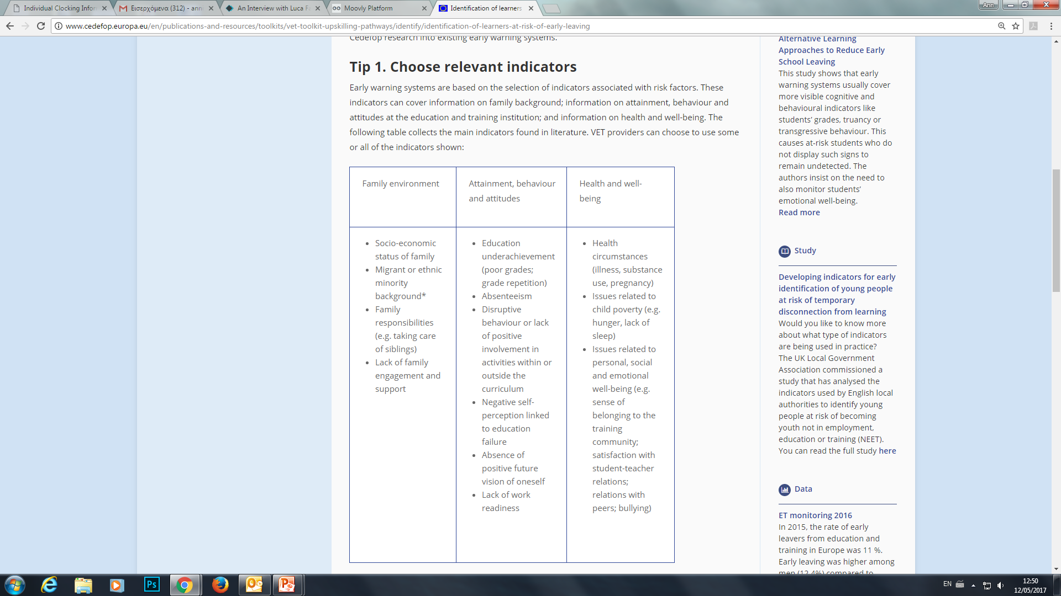

Slide 10
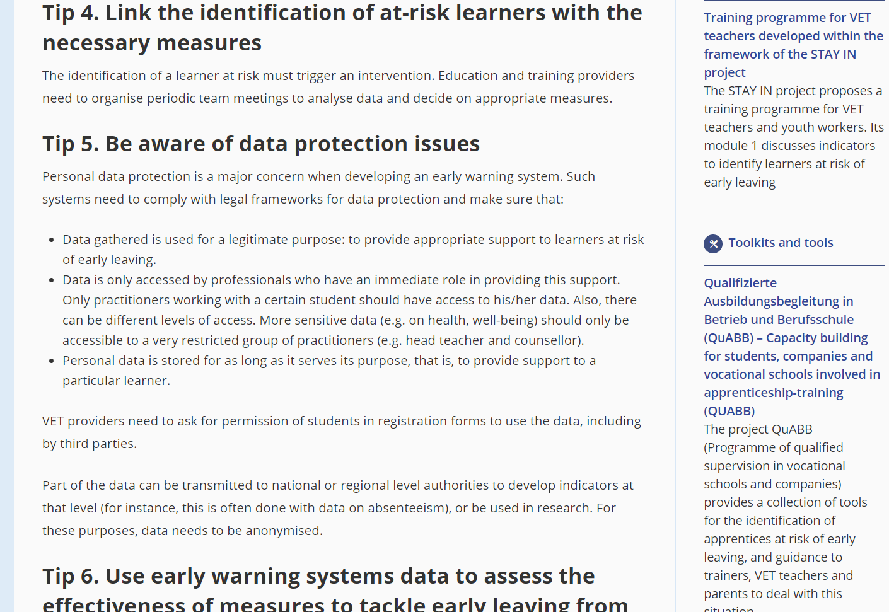
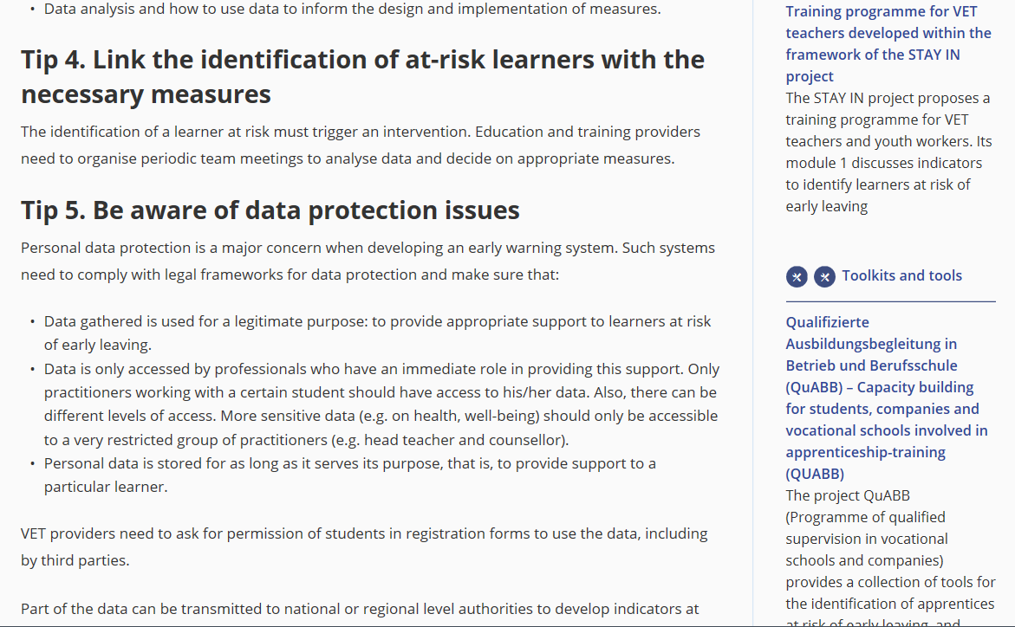
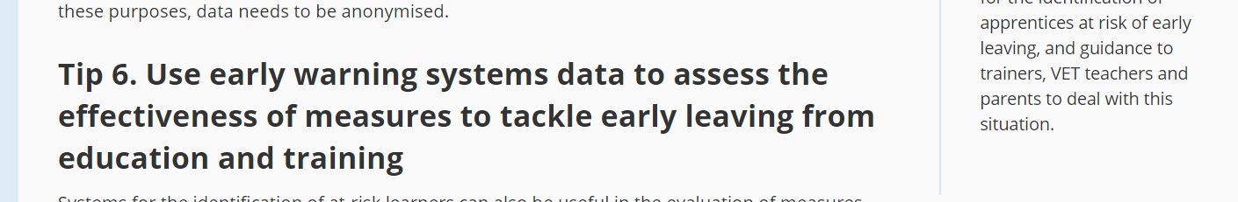

Slide 11
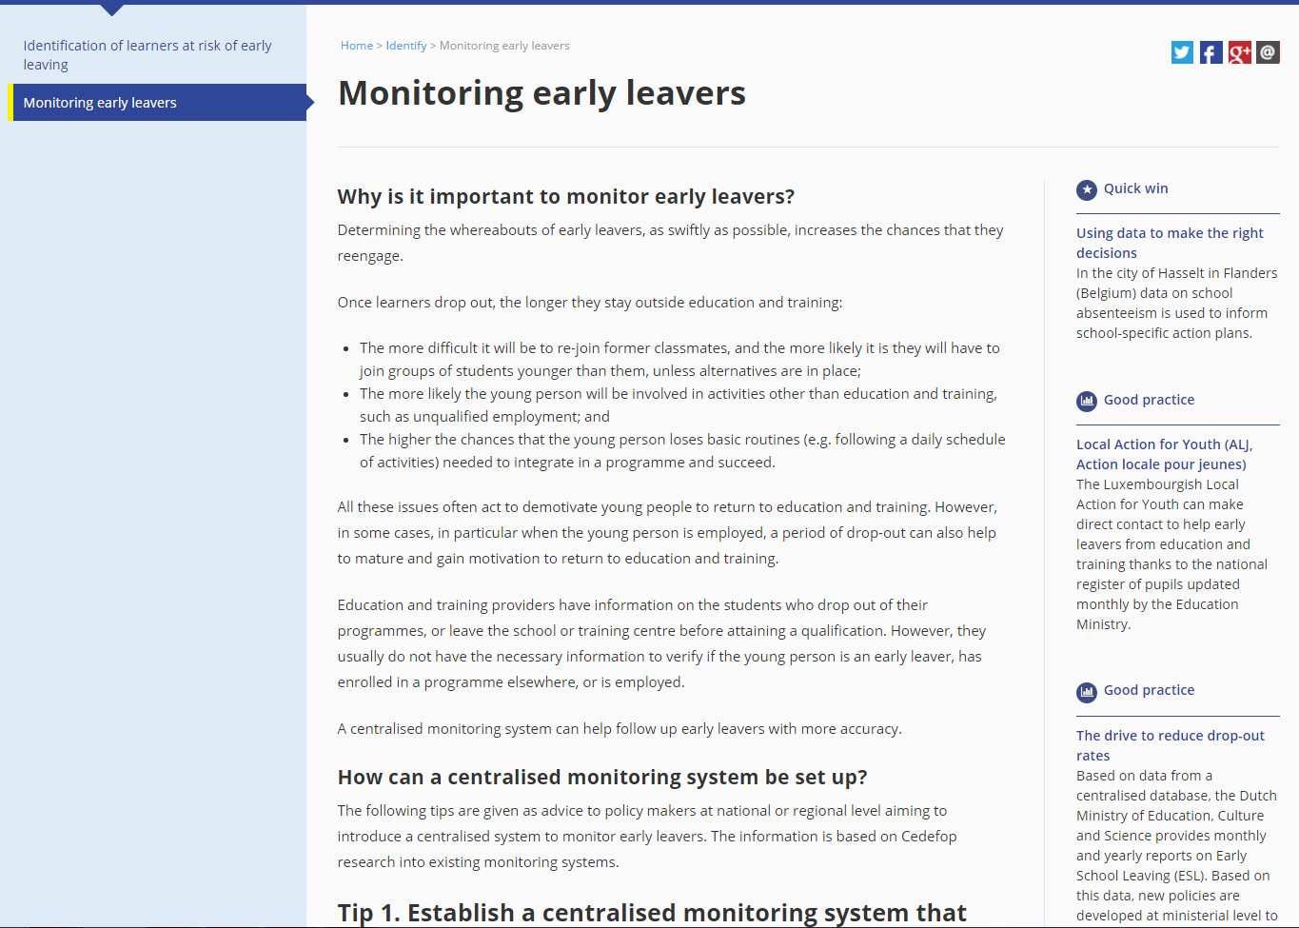
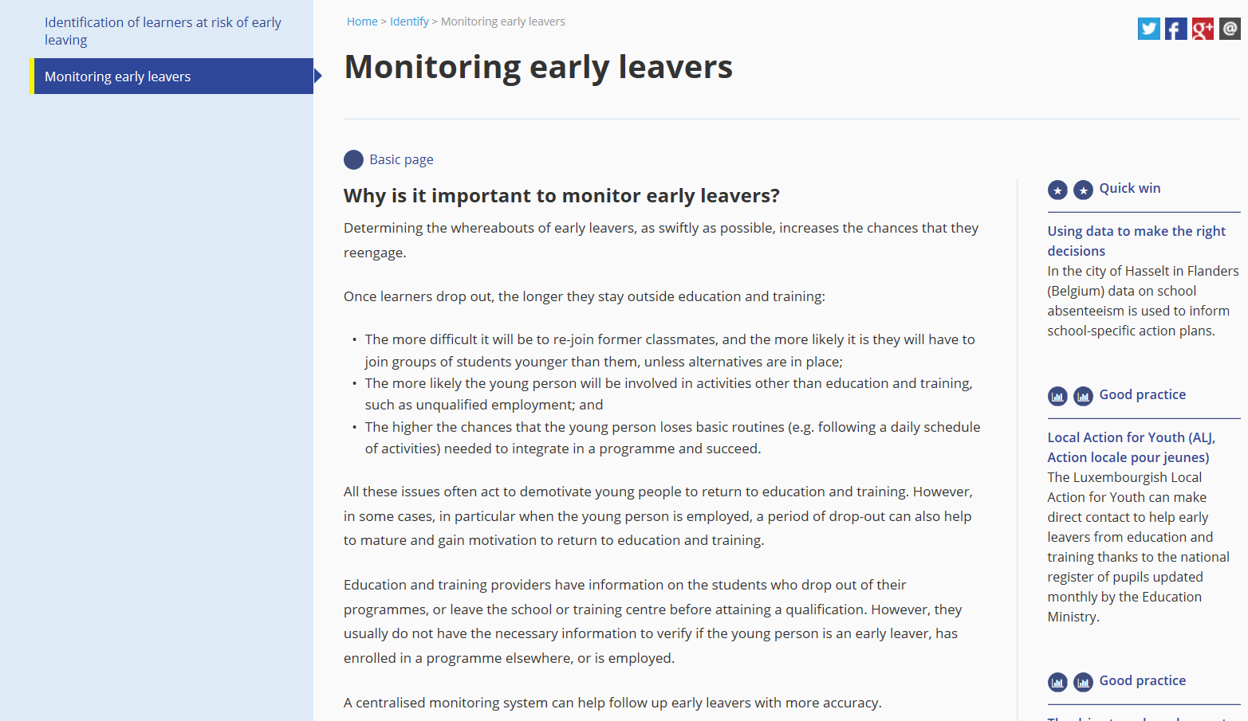

Slide 12
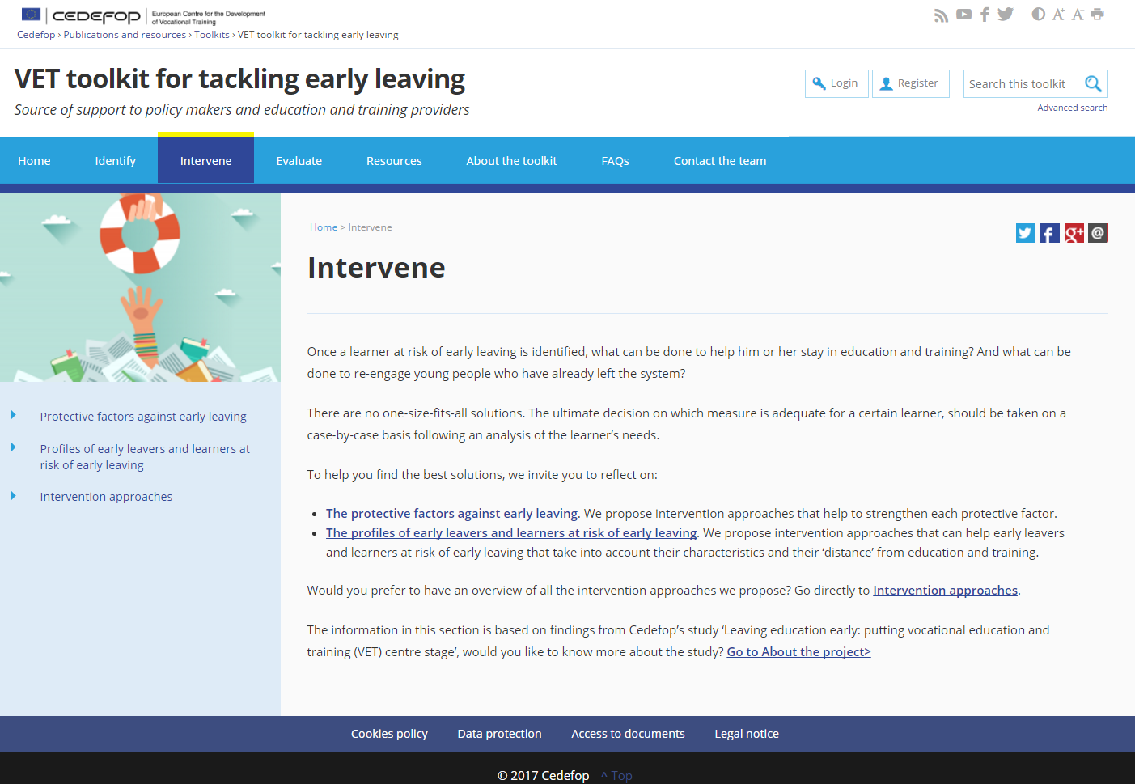

Slide 13
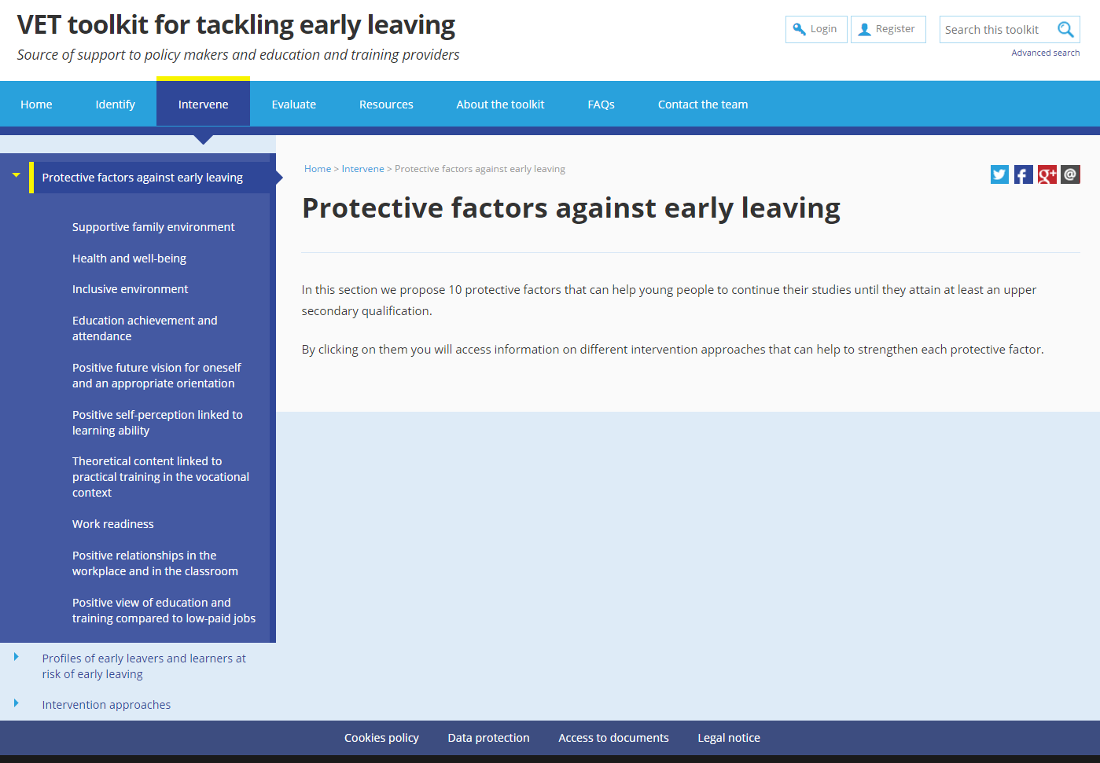

Slide 14
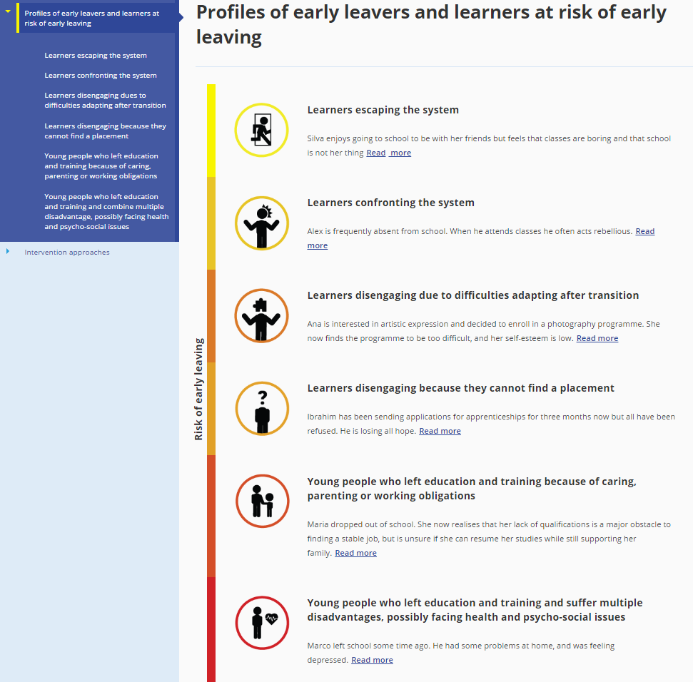

Slide 15


Slide 16
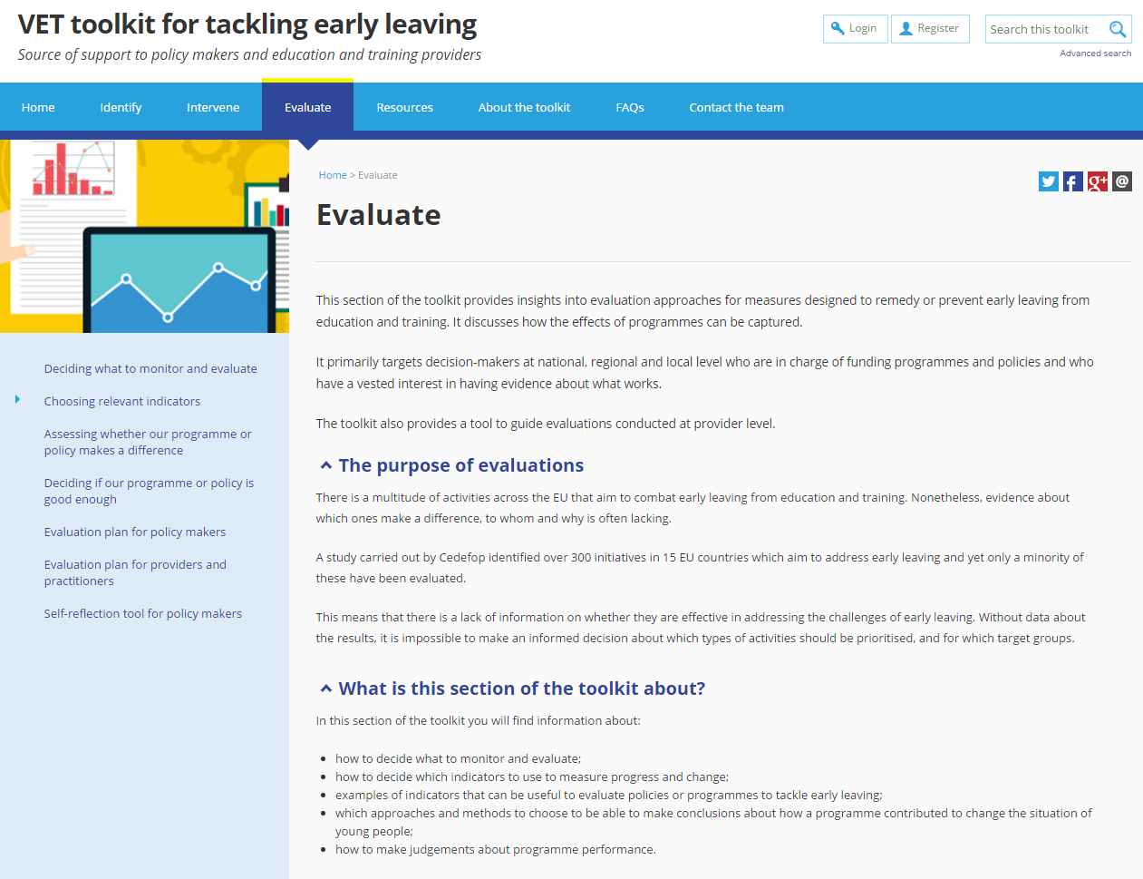

Slide 17
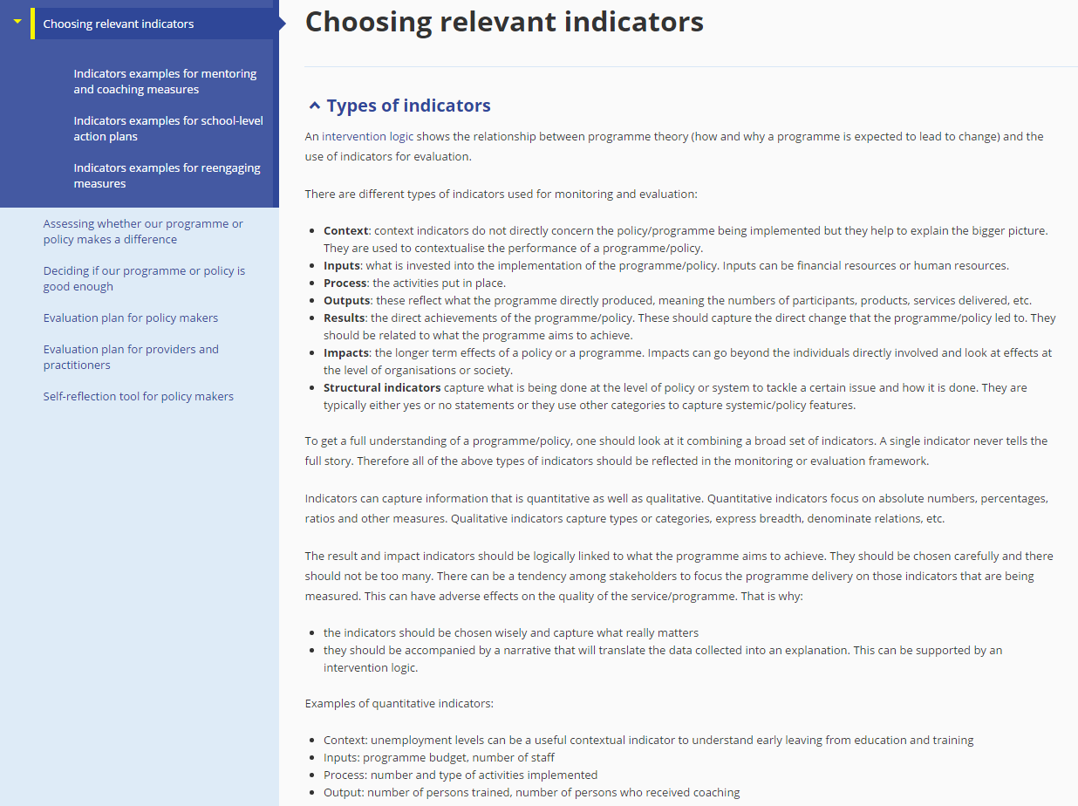

Slide 18
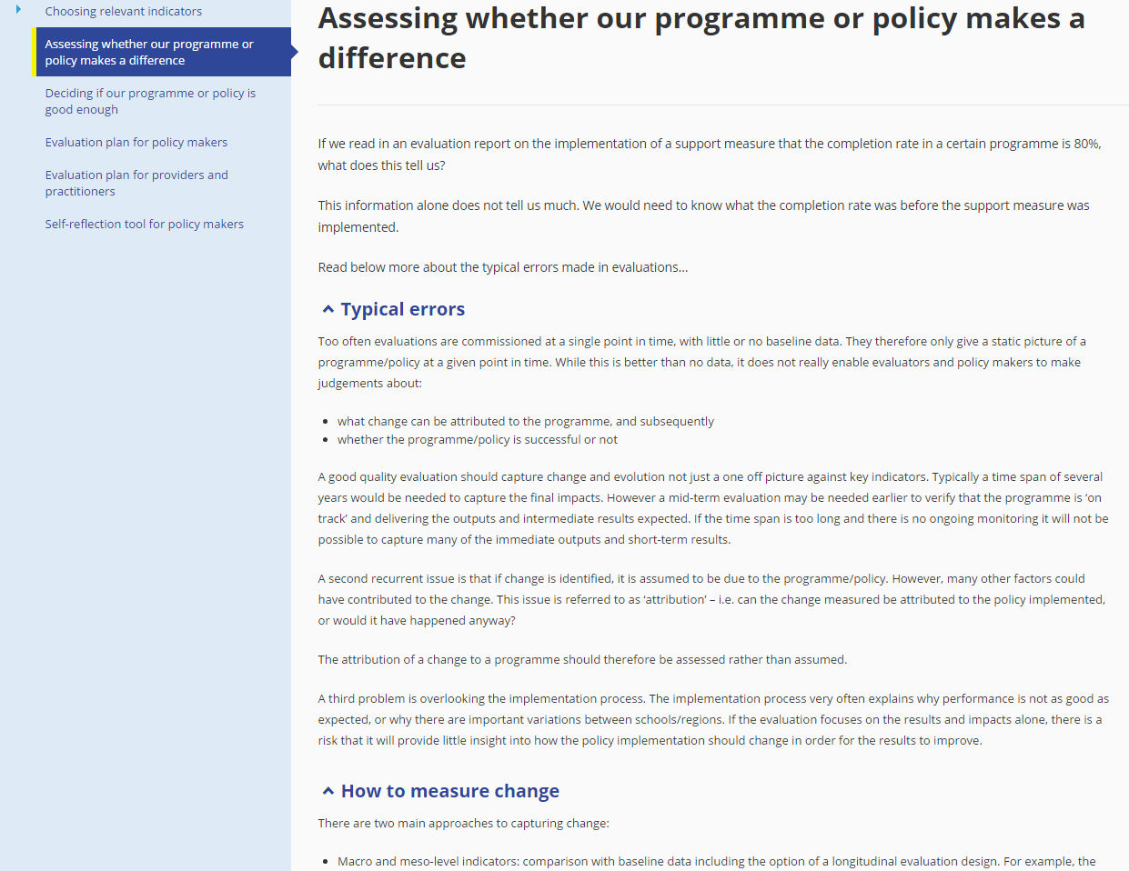

Slide 19
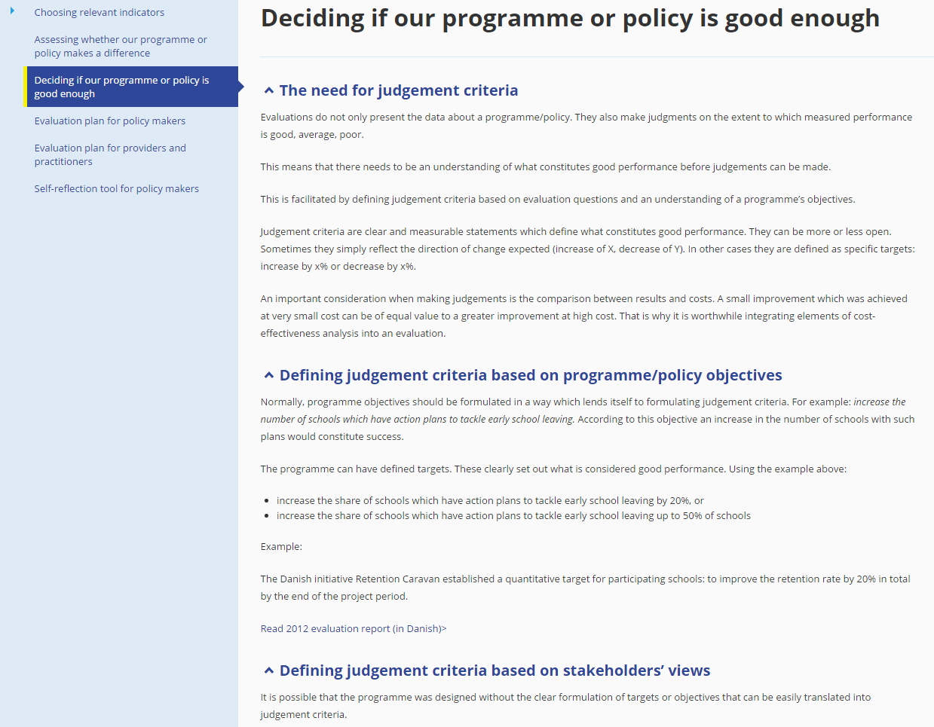

Slide 20
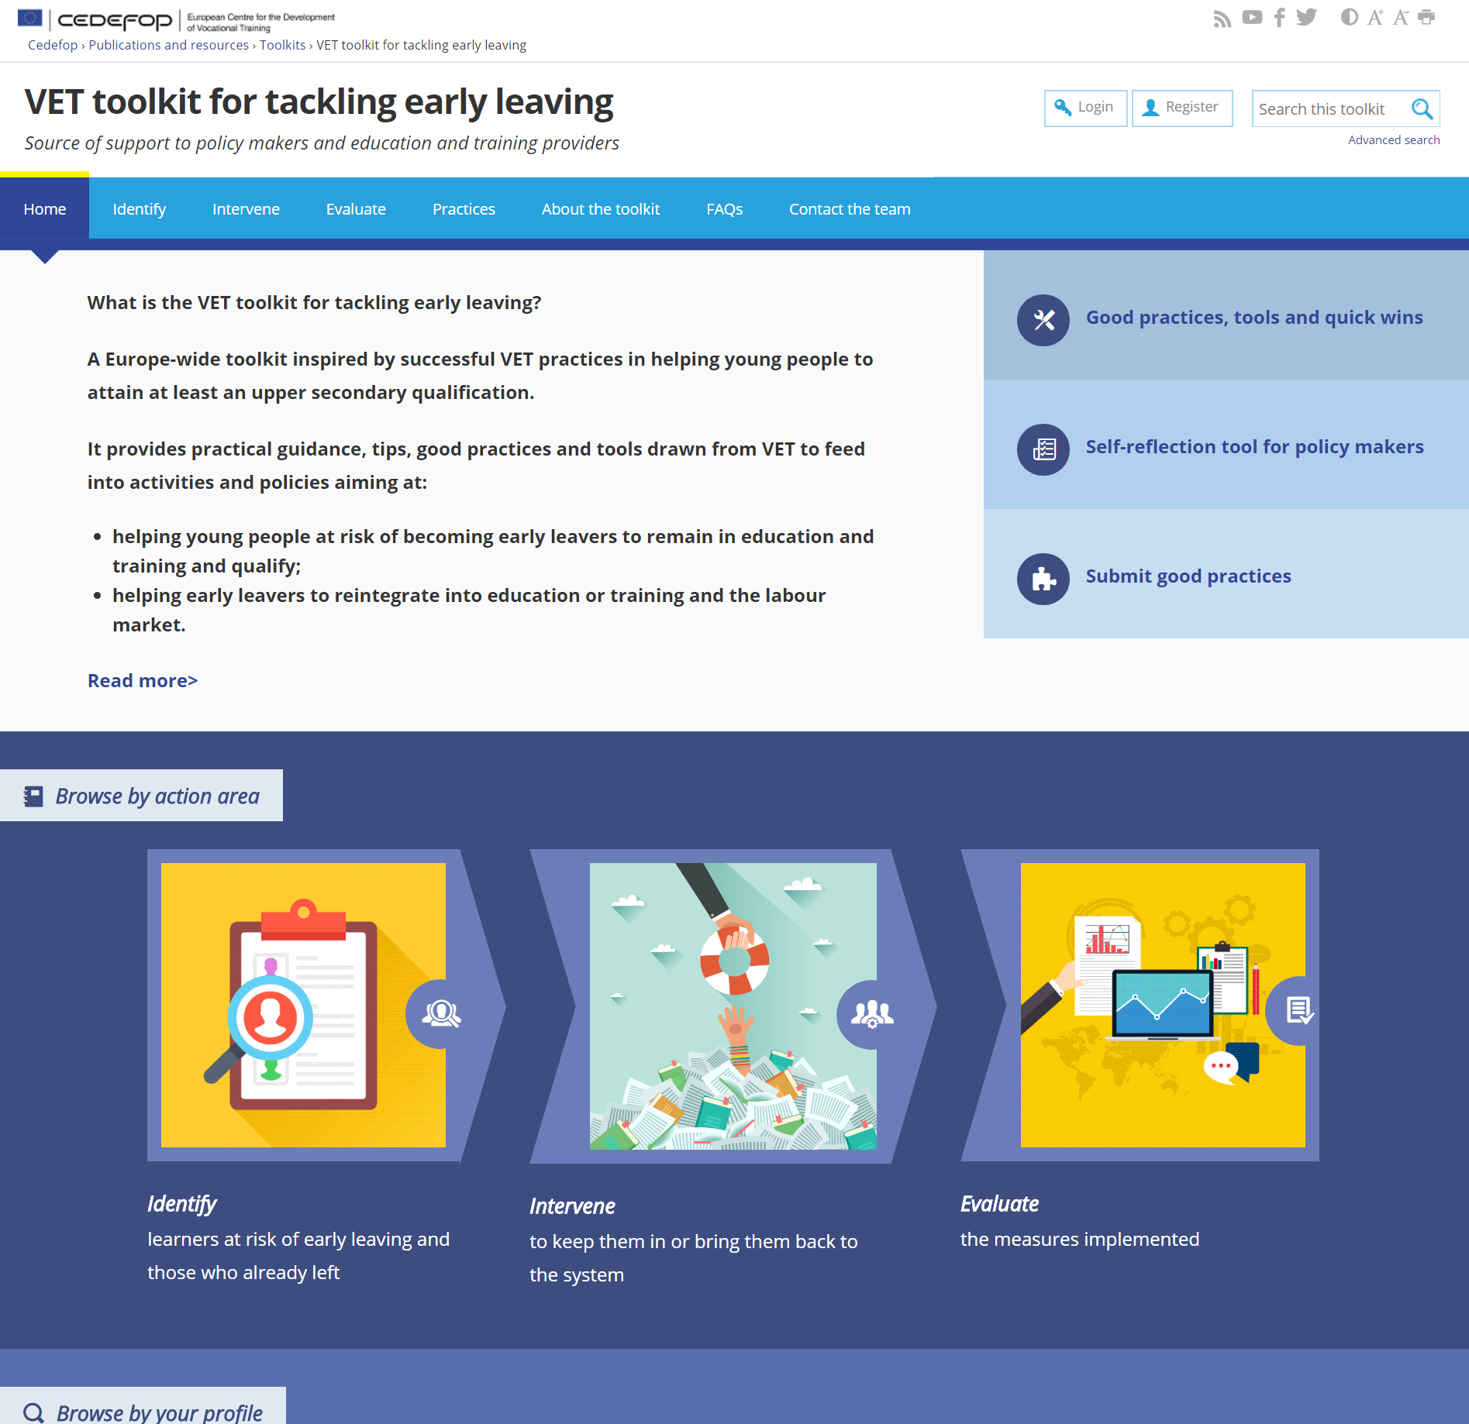
NOW WE GO
ONLINE!

