Slide 1



Policy Learning Forum
VET as a Solution to Early Leaving from Education and Training
Janssen Teixeira
Education Global Practice
Thessaloniki May 16, 2017

Slide 2


Why debating ELET?
Sok Chanchay, 10th grader
Loiq Soibov, 9th grader

Slide 3
Six countries, different approaches, successful policies
4 countries, one common initiative, and some differences
1 country, a combination of school-level with systemic interventions
1 country, focus is on one of the key predictors of early school leaving

Slide 4


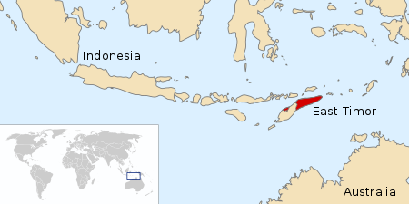
Six countries, different approaches, successful policies

Slide 5
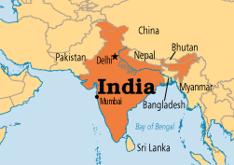
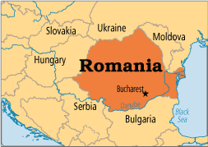
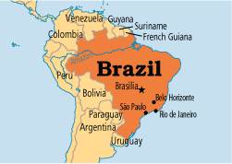
Six countries, different approaches, successful policies

Slide 6
Successful Policies/Initiatives
Identification of at-risk students
Focus on early intervention (for early learning; school readiness)
Ensure grade transition to reduce repetition
Student engagement; after school programs; school-community collaboration

