Slide 1
THE SABER EQUITY AND INCLUSION FRAMEWORK:
Institutions, Practices and Results for Europe and Central Asia
Cristian Aedo
May 2017, Thessaloniki

Slide 2
Outline
Why do countries invest in Equity and Inclusion?
What challenges exist?
What is SABER-Equity and Inclusion?
What interventions increase student learning with an Equity and Inclusion focus?

Slide 3
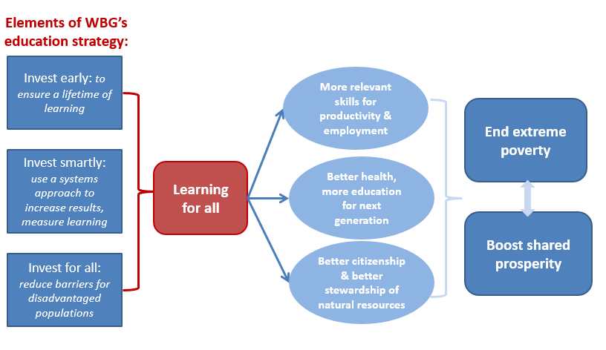
1. Why do countries invest in E&I?
At the global level equity is a guiding theme in the Sustainable Development Goals.
E&I in education are essential to enable all children to acquire a minimum level of learning and for families to emerge from poverty
E&I is key in the WBG and Education Global Practice strategy.
Notes:
E&I are at the core of the World Bank Group’s twin goals of eradicating extreme poverty and building shared prosperity.
Within the Education Global Practice, promoting E&I is a core component of the Education Sector Strategy 2020 which aims to help countries improve the capacity of their education systems to promote learning, including among the most disadvantaged populations.

Slide 4
2. What challenges exist?
Despite substantial progress toward education and learning for all, massive challenges remain:
      Uneven access to early childhood education.
      More children do not learn enough while in school.
      Important and persistent inequalities remain in terms of learning.
      Many children drop out of school without completing secondary school.
Notes:
Many children drop out of school without completing basic education.
Another 63 million children of lower secondary age are out of school, in most cases due to drop out.

Slide 5
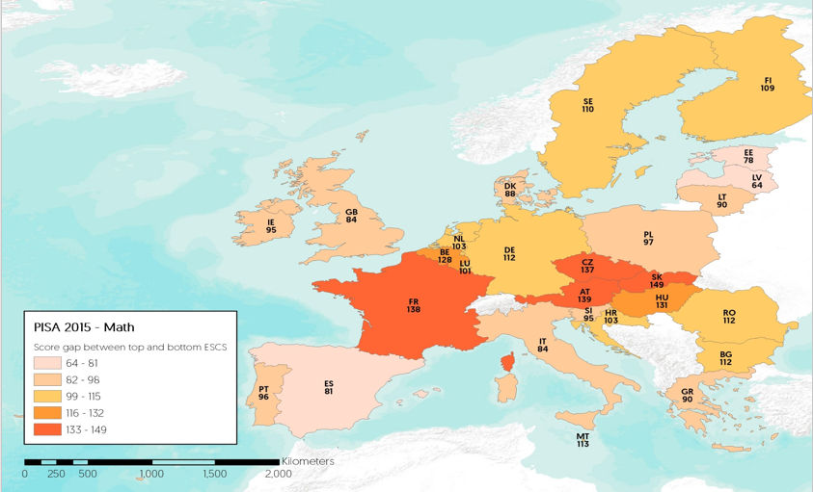
2. What challenges exist?
Important inequalities remain between top and bottom SE quintiles
Notes:
European Union (EU)
Belgium (BE) Greece (EL) Lithuania (LT) Portugal (PT)
Bulgaria (BG) Spain (ES) Luxembourg (LU) Romania (RO)
Czech Republic (CZ) France (FR) Hungary (HU) Slovenia (SI)
Denmark (DK) Croatia (HR) Malta (MT) Slovakia (SK)
Germany (DE) Italy (IT) Netherlands (NL) Finland (FI)
Estonia (EE) Cyprus (CY) Austria (AT) Sweden (SE)
Ireland (IE) Latvia (LV) Poland (PL) United Kingdom (UK)
European Free Trade Association (EFTA)
Iceland (IS) Norway (NO)
Liechtenstein (LI) Switzerland (CH)

Slide 6
2. What challenges exist?
Addressing the learning challenge and its inequalities is key as well in view of the global trends:
      New concepts on what does it mean to be a “well-educated” person in the 21st century.
      Demands for skills are changing towards jobs requiring non-routine (cognitive and interpersonal) skills.
      Technologies (robots) are taking on jobs.
      In a context in increased urbanization.
Notes:
Skill set requiring cognitive, technical and socio-emotional skills
Urbanization comes with jobs involving tasks that require more communication, thoughts and personal interactions (e.g. services, professionals)

Slide 7
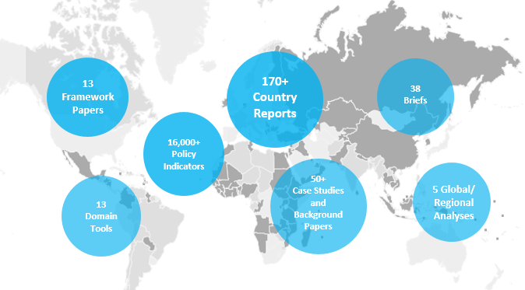
3. What is SABER-Equity & Inclusion?
The Systems Approach for Better Education Results (SABER) is an initiative to collect and disseminate comparative data and knowledge on education policies, to help countries systematically evaluate and strengthen their education systems.
Notes:
SABER produces data on education policies and institutions, analyzes and evaluates their quality, and provides decision makers and stakeholders at all levels with assessments.
These assessments help countries better understand the strengths and weaknesses of their education systems, highlighting actionable steps that can be taken based on global best practice, and also foster structured and informed policy dialogue on how to most effectively strengthen education policies and policy implementation that can improve learning outcomes on the ground. SABER also improves the education systems knowledge base for education reforms.
Since its inception, SABER tools and frameworks have been applied in more than 130 countries around the world, SABER has produced 13 what matters framework papers which provide evidence based frameworks and tools to help analyze education system areas, along with over 170 SABER country reports, which document the systematic application of SABER to inform policy dialogue. In addition, SABER has produced a number of global/regional analyses, case studies and SABER in Action briefs across domains.

Slide 8
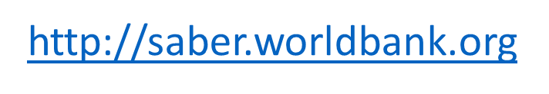
3. What is SABER-Equity & Inclusion?
SABER and the Results Chain for Learning
Education inputs
Quality of policies & institutions
Quality of policy implementation
Quality and quantity of education delivered
Learning For All (outcomes)
SABER Policy intent
SABER Policy Implementation
School & household surveys
Notes:
What’s next for SABER?
SABER views the links between education inputs and outputs as a chain that should translate policies and resources into quality learning outcomes. In practice, however, “good” policies are not always well implemented. As a next step, SABER is developing tools to assess the quality of policy implementation to ensure adopted programs have their intended impact.
The last five years of the SABER program have focused on policy intent and policy enabling environment. In the past year, we began to move more into policy implementation, examining how services are delivered on the ground through the new SABER Service Delivery tool.
In FY17, the tool is being piloted in Laos, Afghanistan, Punjab (Pakistan), and Tanzania. The development of the survey instruments is ongoing; however, the completed tool will be available in early FY18.
In addition to the SABER Service Delivery tool, we have several other ongoing programs under development, including the Systems Snapshot tool, a new domain (Standards, curriculum, and textbooks), a quality of teacher training tool, and a classroom observation tool among others.

Slide 9
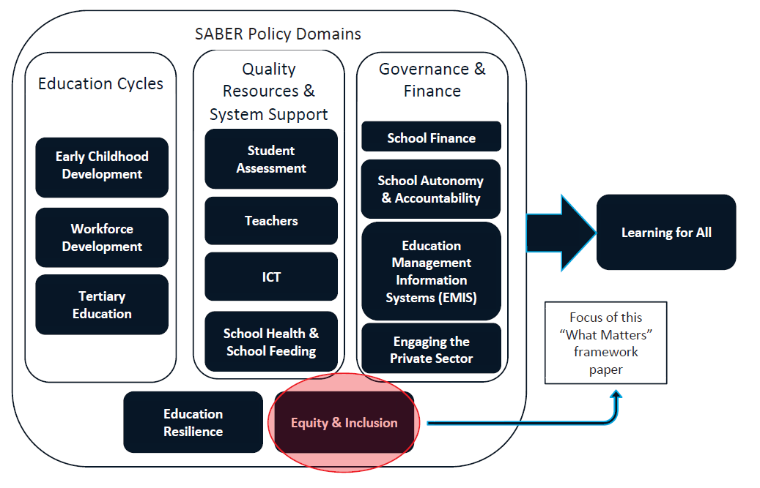
3. What is SABER-Equity & Inclusion?
SABER is currently organized in 13 domains or areas of education policymaking within an education system
Focus of this presentation
Notes:
SABER’s detailed data-gathering and analysis are organized by “domains,” or areas of education policymaking within an education system.
These currently include levels of education (early childhood development, primary and secondary, workforce development, and tertiary), types of quality resources and supports (school finance, school health and school feeding, and teachers), areas of governance (engaging the private sector and school autonomy and accountability), information sources (education management information systems and student assessment), and complementary inputs and cross-cutting themes (equity and inclusion, information and communication technologies, and resilience).

Slide 10
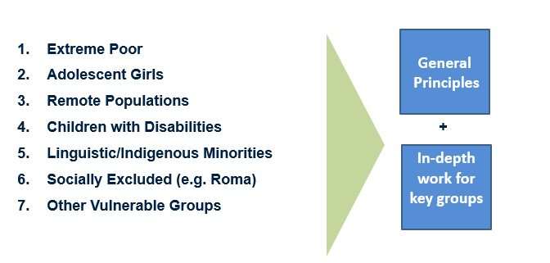
3. What is SABER-Equity & Inclusion?
E&I challenge: Multiple (and heterogeneous) vulnerable groups with different needs and facing different risks.

Slide 11
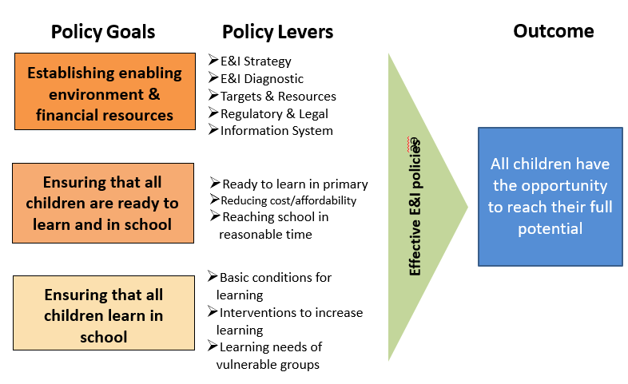
3. What is SABER-Equity & Inclusion?
SABER E&I Framework
Notes:
SABER-E&I, one of the domains most recently developed, documents and analyzes policies that promote equity in access to education and learning.
Of the many policies under the control of governments, the allocation of public spending is one of the most important factors affecting equity in access to education and learning.
But the domain also considers other policies, including the regulation of for-profit and non-profit private schools, as well as mechanisms related to affordability, cost recovery, and incentives for schooling and learning.
The SABER-E&I framework helps policymakers ensure that children and youth from disadvantaged groups are able to learn.
Unlike many of the other domains, the SABER-E&I domain does not rely on standardized data collection tools to rate policies at the country level because issues of E&I can differ markedly between countries. Instead, the SABER-E&I domain provides a framework with which in-depth country studies can be conducted.

Slide 12
3. What is SABER Equity & Inclusion?
SABER-E&I aims at supporting governments in their efforts to provide education results by:
Providing a comprehensive framework based on a review of global evidence and related diagnostic tools.
Aiding countries in analyzing their education systems through diagnostic, dialogue and reform.
Enhancing the global knowledge base on effective policies.
Enabling cross-country learning and fostering informed dialogue and decision making using a structured framework.
Involving key system leaders and stakeholders in identifying reform priorities.

Slide 13
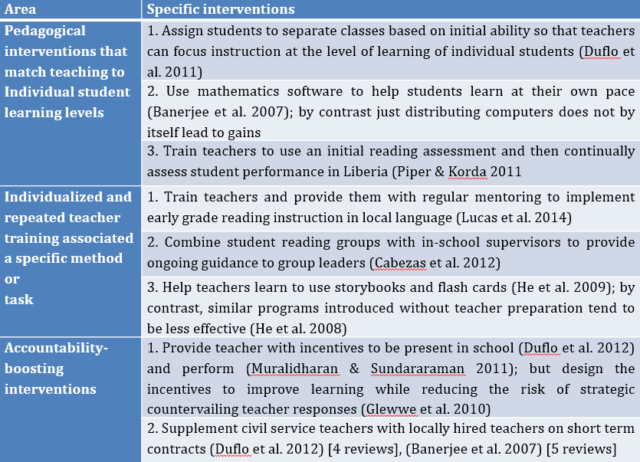
4. What interventions increase student learning with an E&I focus?
Notes:
The literature on learning is vast, but systematic literature reviews have been conducted to identify the types of interventions that are most effective in improving learning outcomes for students. Probably tens of thousands of articles have been published on factors affecting student learning. Even when one restricts the literature to rigorous impact evaluations carried out in developing countries, the number of studies remains large. Despite some divergence in findings, existing literature reviews point to some common sets of interventions that are likely to improve learning.
Evans and Popova (2015) suggest that three types of interventions tend to be recommended across multiple reviews: (1) pedagogical interventions that match teaching to individual student learning levels; (2) individualized, repeated teacher training associated with a specific method or task; and (3) accountability-boosting interventions. They list a number of specific interventions in each of these three broad areas that have proven successful.
This does not mean that other interventions cannot be successful or are not required, but these were the interventions for which there seemed to be a consensus on effectiveness.
Importantly, many of the interventions listed in the table can be considered to incorporate an E&I focus because they are to a large extent designed to enable teachers to focus on those students who have the most difficulty, adapting both the level and mode of instruction to their needs.

Slide 14
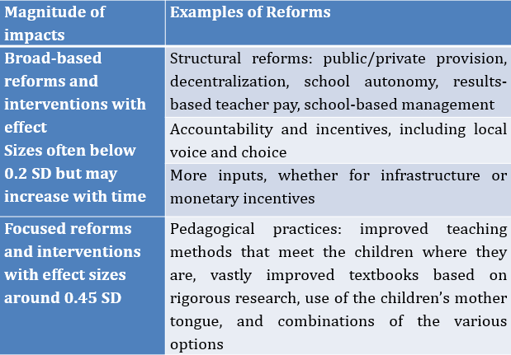
4. What interventions increase student learning with an E&I focus?
Notes:
The magnitude of the gains that can be achieved by recommended interventions are, however, not the same for all interventions. Moreover, sequencing matters.
Crouch and DeStefano (2015) suggest that there may be a dichotomy in the size of the gains that various types of reforms and interventions can be expected to generate.
They argue that the impact of broad-based reforms and interventions (i.e., structural reforms, reforms related to accountability and incentives, and the provision of more inputs) tend to have smaller impacts than interventions that focus on specific pedagogical practices
The types of reforms that the authors had in mind for the various categories are illustrated in the table.
The impact of the focused interventions was typically larger. This does not mean that broad-based reforms are not needed—they may very well be a prerequisite in order to implement more focused pedagogical reforms at scale in national education systems.
Teachers and schools must be accountable for those reforms to succeed as well.
But it is important to note that the two types of reforms may have impacts of different orders of magnitude and that broad-based reforms may take longer to bear fruit, as already mentioned.

Slide 15
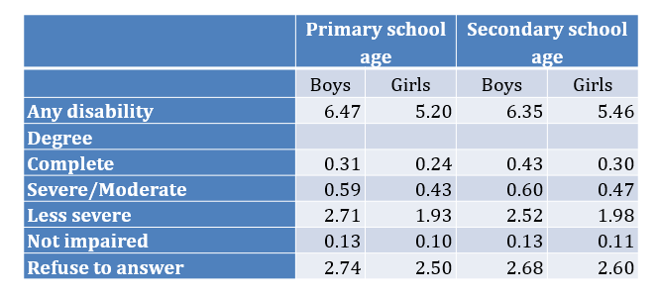
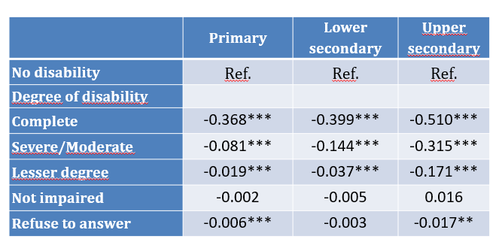
4. What interventions increase student learning with an E&I focus?
In-depth Work on Selected Vulnerable Groups: Children with Disabilities Poland 2011.
Marginal Impact of Disability on Completion.
Notes:
The magnitude of the gains that can be achieved by recommended interventions are, however, not the same for all interventions. Moreover, sequencing matters.
Crouch and DeStefano (2015) suggest that there may be a dichotomy in the size of the gains that various types of reforms and interventions can be expected to generate.
They argue that the impact of broad-based reforms and interventions (i.e., structural reforms, reforms related to accountability and incentives, and the provision of more inputs) tend to have smaller impacts than interventions that focus on specific pedagogical practices
The types of reforms that the authors had in mind for the various categories are illustrated in the table.
The impact of the focused interventions was typically larger. This does not mean that broad-based reforms are not needed—they may very well be a prerequisite in order to implement more focused pedagogical reforms at scale in national education systems.
Teachers and schools must be accountable for those reforms to succeed as well.
But it is important to note that the two types of reforms may have impacts of different orders of magnitude and that broad-based reforms may take longer to bear fruit, as already mentioned.

Slide 16





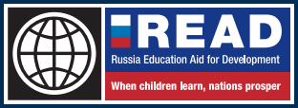






Partners
Notes:
Who do we work with?
A number of global partnership programs and donors have supported the development of SABER including Russia (through the Russia Education Aid for Development, or READ); the Children’s Investment Fund Foundation (CIFF); the Department for International Development (DFID) of the UK; the United Nations Educational, Scientific, and Cultural Organization (UNESCO); the Arab League Educational, Cultural and Scientific Organization (ALECSO); the World Food Programme (WFP); the United Nations Children’s Fund (UNICEF); the Netherlands BNPP program; Korea's KTF program; and the Pacific Facility Program of Australia's Department of Foreign Affairs and Trade (DFAT).
SABER tools have been used in partnership with several notable organizations, including: Australian Department of Foreign Affairs and Trade (DFAT), Education for All Teacher Task Force, Korean Education Research and Information Service (KERIS), Korean Trust Fund, Organization for Economic Cooperation and Development (OECD), PISA for Development, Russia Education Aid for Development (READ), U.K. Department for International Development (DFID), United Nations Children’s Fund (UNICEF), and World Food Programme (WFP).

Slide 17
Thank YOU
For more information, contact:
Cristian Aedo (caedo@worldbank.org)

